Slide 1
Cyber Security – Where does technology stop and where should we stop it?
Stefan Schmid (Faculty of Computer Science, University of Vienna)
ICISSP 2020 Panel Session

Slide 2
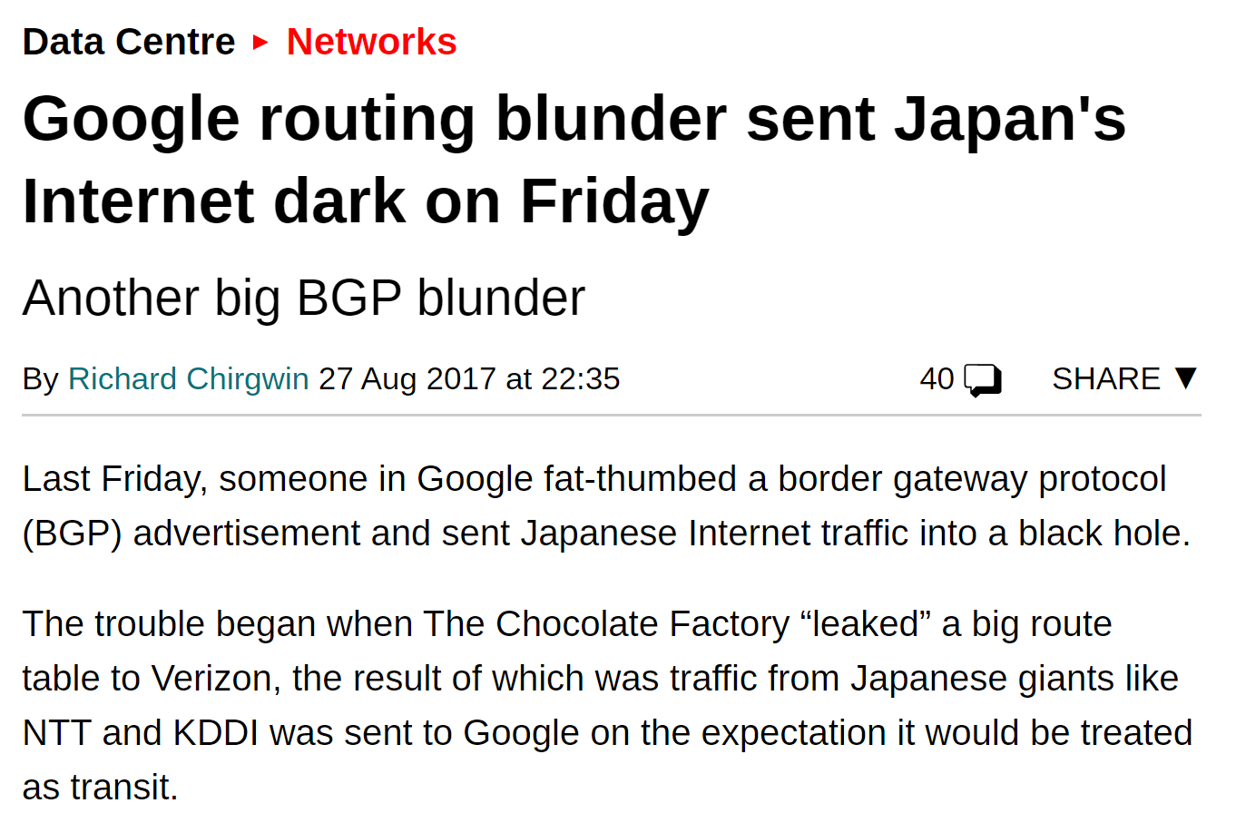

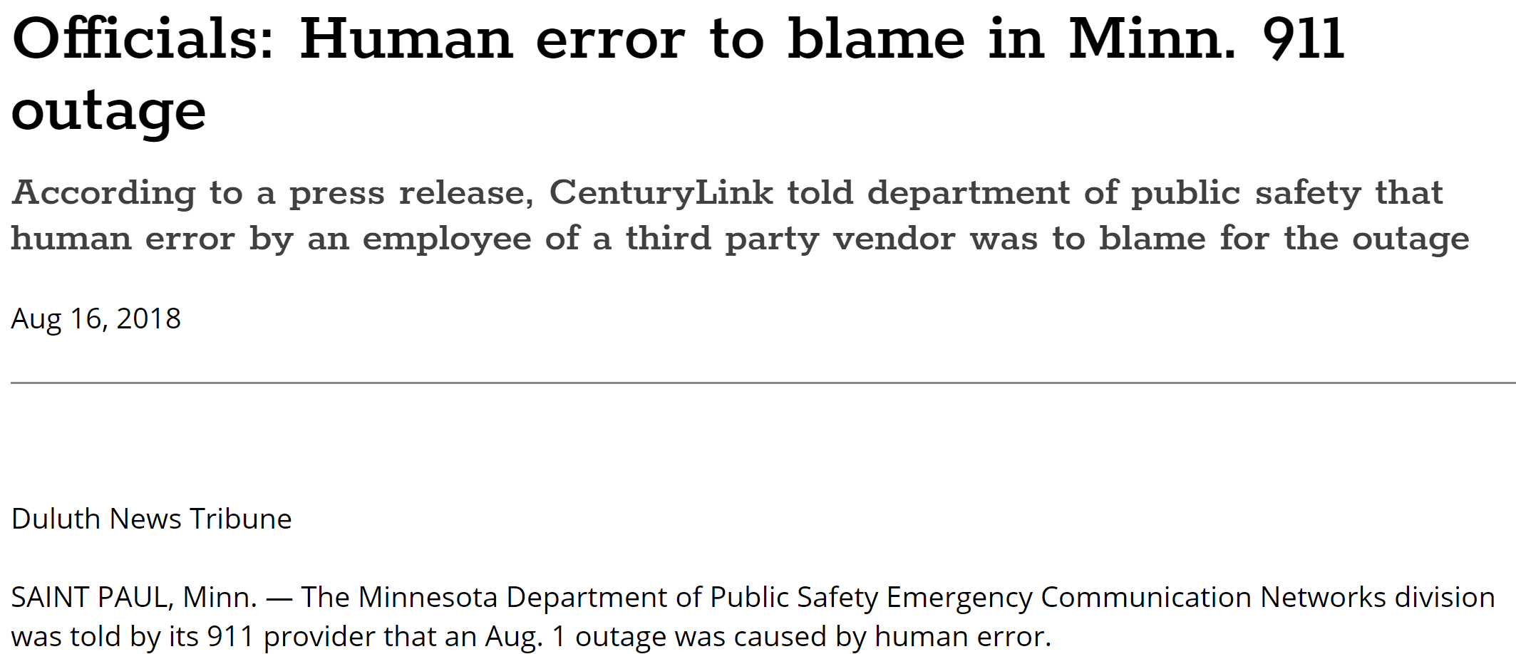
Obviously: We Need Technology
In my field, communication networks, many outages are due to human errors, e.g.:
… 1000s passengers stranded…
… even 911 services affected!
Entire countries disconnected…
A major effort is made to make networks more automated, programmable and “self-driving”.

Slide 3
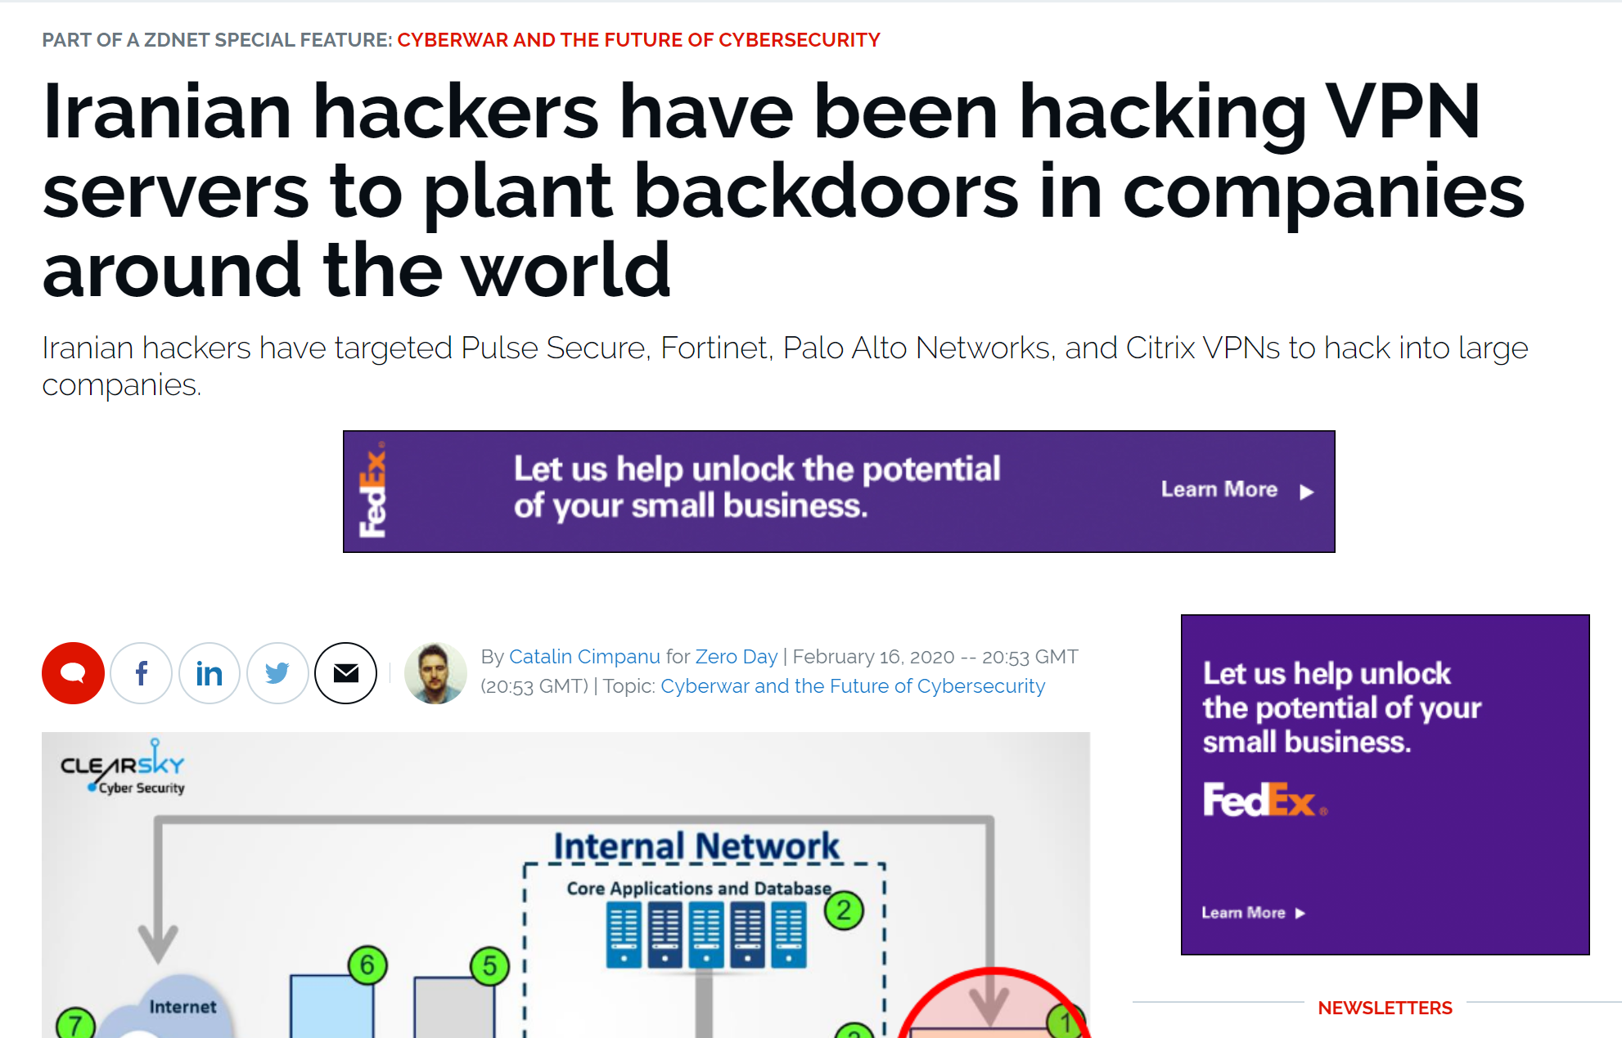
But: How much can we trust technology?
February 2020: Iranian hackers have targeted Palo Alto Networks and others to hack into large companies.

Slide 4
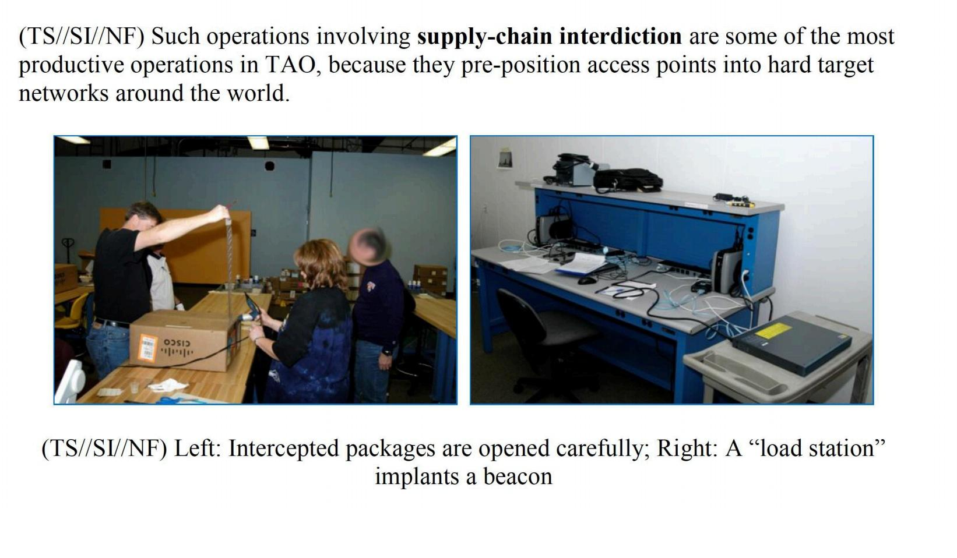


But: How much can we trust technology?
Hardware backdoors and exploits
But how can we build a secure network if the underlying hardware can be insecure?!

Slide 5
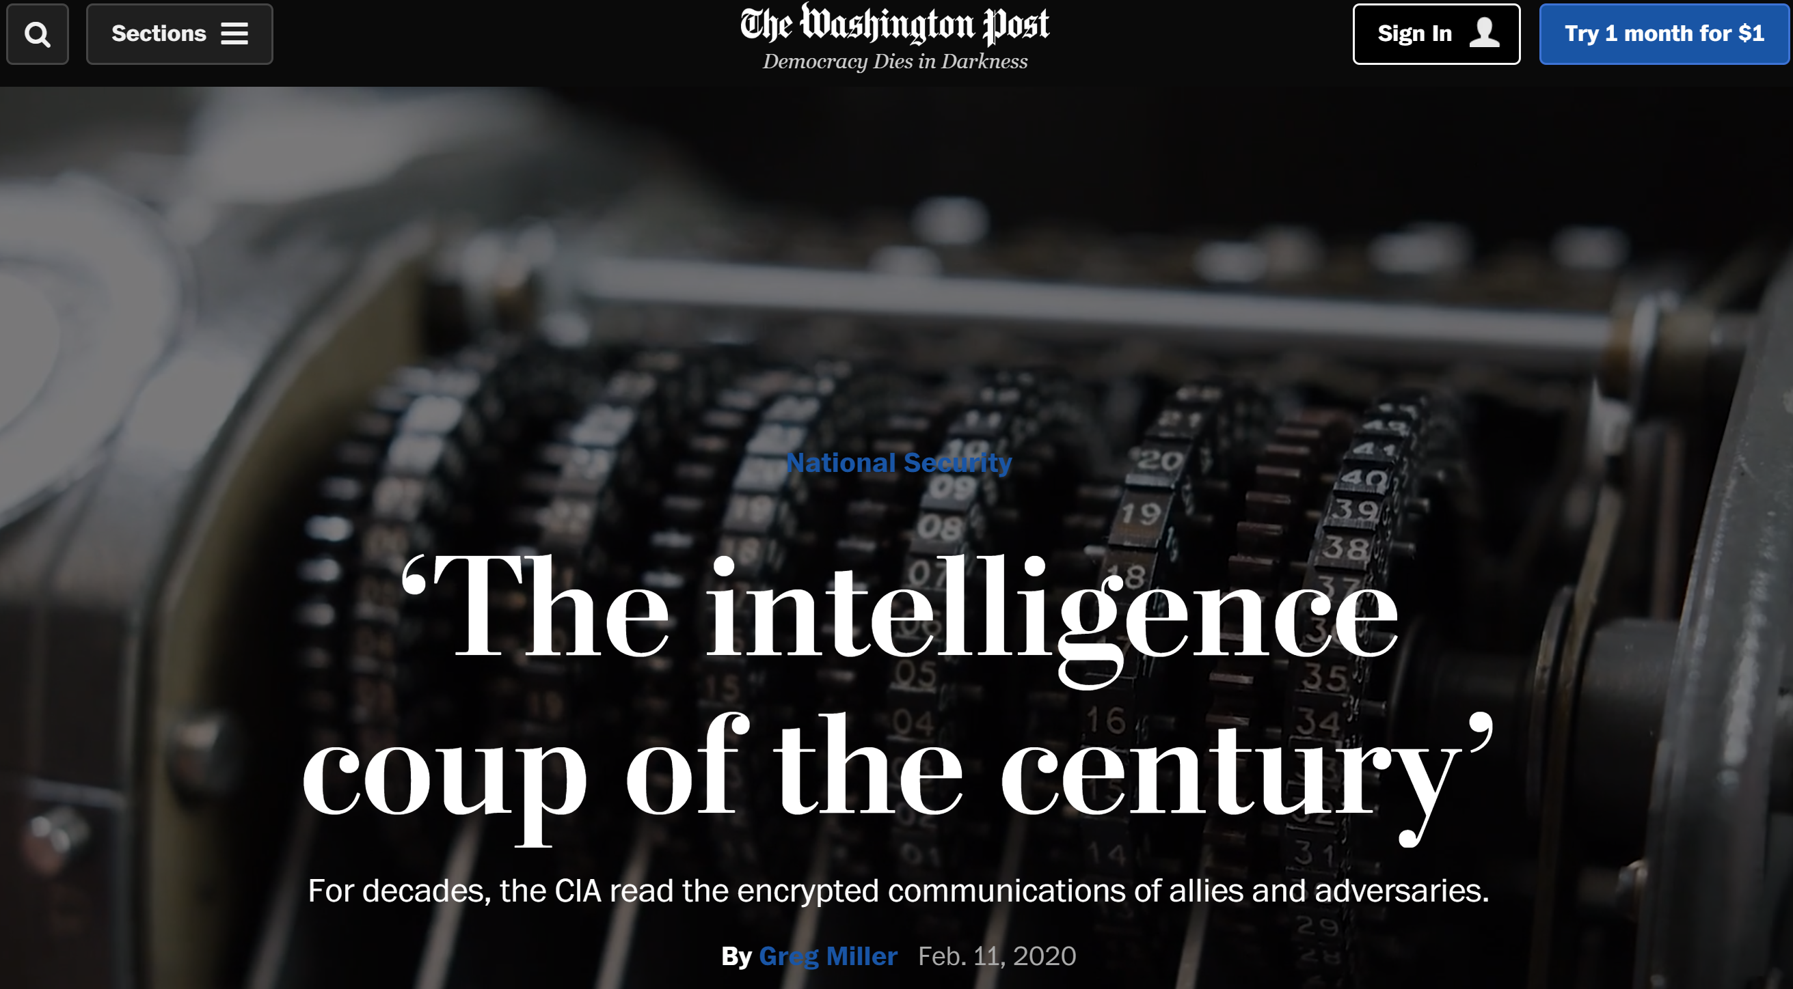
But: How much can we trust tech companies?
February 2020: For more than half a century, governments all over the world trusted a single company to keep the communications of their spies, soldiers and diplomats secret. But: Crypto AG was secretly owned by the CIA.

Slide 6
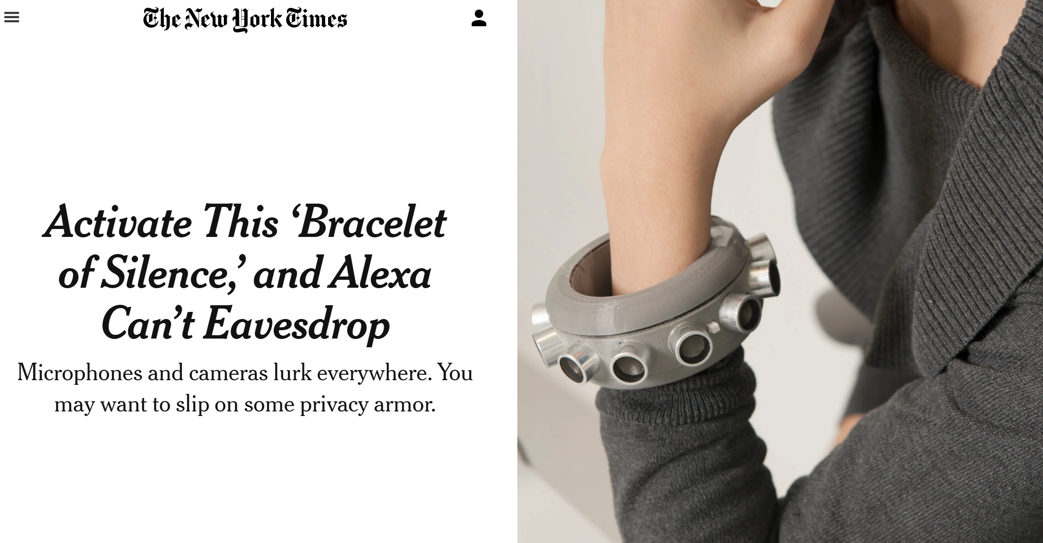
First Creative Efforts for Self-Protection
February 2020: Wearable microphone jamming.
(https://www.mirror.co.uk/tech/alexa-owners-can-stop-eavesdropping-21539032)

Slide 7

Another Example: Wearable Camera Jamming
Glasses developed by Scott Urban reflect infrared light from security cameras to blur out the wearer’s face.

Slide 8
Back to Networks…
Automation and technology is good
Adoption could be faster: conservative business
Do we need to stop technology? The wrong question: we cannot anyway.
And with IoT we already lost anyway.
But can we at least make sure that technology “with good intensions” does not do more harm, e.g., due to wrong input data, measurements, etc.
Similar to self-driving cars: can technology recognize its own limits? When inputs from human needed?

